Slide 1

DATABASE SYSTEMS (EIE36E): Transaction Statements
Doc. Ing. Václav Vostrovský Ph.D.
Ing. Petr Hanzlík

Slide 2

Outline > Transaction statements
Transaction statements
Commit
Savepoint
Rollback

Slide 3
Transaction Statements
SQL-Transaction Statements are the subset of SQL, that is also called the Transaction Control Language for SQL (SQL TCL).
A transaction is a logical unit of work that contains one or more SQL statements. The effects of the SQL statements in a transaction can be either all committed (applied) or all rolled back.

Slide 4
Transaction Statements: Commit
The COMMIT statement terminates the current transaction and makes all changes under the transaction persistent.
SQL COMMIT syntax:
COMMIT;

Slide 5
Transaction Statements: Savepoint
SAVEPOINT is optional and is used to rollback a partial transaction to the specified savepoint.
SQL COMMIT syntax:
* Savepoint is not implemented in the web interface
SAVEPOINT <savepoint_name>

Slide 6
Transaction Statements: Rollback
The ROLLBACK statement terminates the current transaction and restores the data state after last commit.
SQL ROLLBACK syntax:
ROLLBACK [TO <savepoint> ];

Slide 7
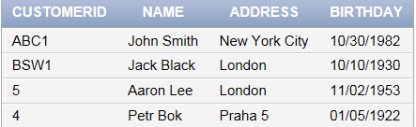
Transaction Statements: example
Take back a delete
COMMIT; // to make sure the last transaction has been processed
SELECT * FROM customer;
DELETE customer WHERE name='Aaron Lee‘;
SELECT * FROM customer;
Notes:
Do not forget to turn autocommit off!

Slide 8
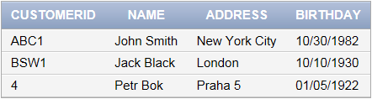
Transaction Statements: example
ROLLBACK;
SELECT * FROM customer;
Notes:
Do not forget to turn autocommit off!

Slide 9
Transaction Statements: example
Create a savepoint, return data to past state
COMMIT; // to make sure the last transaction has been processed
SELECT * FROM customer;
Notes:
Do not forget to turn autocommit off!

Slide 10
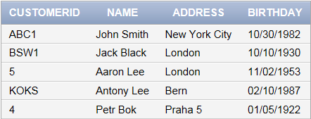
Transaction Statements: example
INSERT INTO customer
VALUES ('KOKS','Antony Lee','Bern','02.10.1987')
SAVEPOINT save1;
SELECT * FROM customer;
Notes:
Do not forget to turn autocommit off!

Slide 11
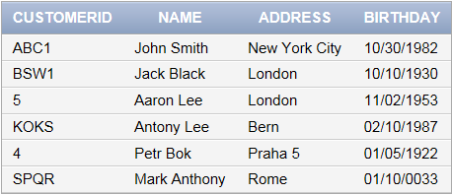
Transaction Statements: example
INSERT INTO customer
VALUES ('KOKS','Antony Lee','Bern','02.10.1987')
SELECT * FROM customer;
Notes:
Do not forget to turn autocommit off!

Slide 12
Transaction Statements: example
ROLLBACK TO save1;
SELECT * FROM customer;
Notes:
Do not forget to turn autocommit off!

Slide 13
Transaction Statements: example
ROLLBACK;
SELECT * FROM customer;
Notes:
Do not forget to turn autocommit off!

